Slide 1
RUGE
Open Source framework for
random testing
Brendan McCarthy
DevClear
Oct 1, 2013

Slide 2
What is RUGE
New OSS framework
Generates and runs integration/system tests
When manually-crafted testing hits the wall
  Diminishing returns
  The more tests, the more costly are changes
Random test generation guided by rules
  Guide random tests toward useful cases
Functional testing + load testing
  Generate lots of realistic (non-skewed) test events
  Reads and writes (side-effect producing)
  Common in financial systems: large streams of events from large numbers of actors over time

Slide 3
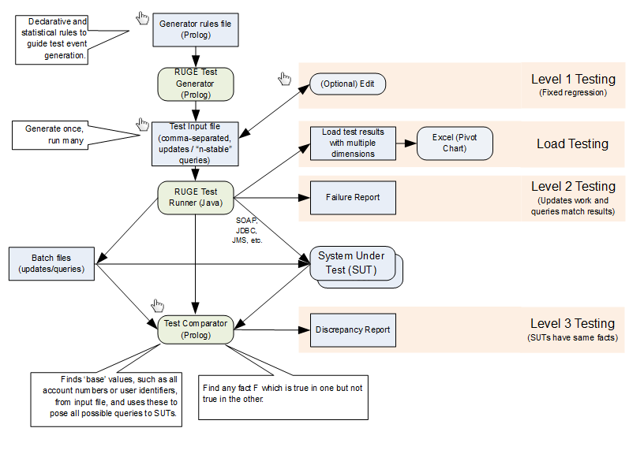
RUGE Components

Slide 4
Motivations
Why not other libraries?
  Generation separated from execution
  Not Prolog (or Prolog-like)
Why Prolog?
  Excels at exploring search spaces
  Straightforward syntax, declarative semantics
  Structures are freely defined without type definitions
  Strong embedded DSL features
    Add operators
    Prolog interpreter in Prolog in 12 or 13 lines of code
    Data is code, code is data
Why Ruge on top of Prolog?
  Prolog alone is depth-first deterministic

Slide 5
Simple Prolog Program
item(rivets).
item(caps).
item(hammers).
item(mallets).
gen :-
item(X),
write(X),
nl,
fail.
gen.
| ?- gen.
rivets
caps
hammers
mallets
| ?-

Slide 6
RUGE Gen Loop
user:file_search_path(ruge,'$RUGE_HOME').
:- include(ruge(common)).
item(rivets).
item(caps).
item(hammers).
item(mallets).
| ?- gen(item).
item(rivets).
item(caps).
item(hammers).
item(mallets).
| ?-
Beyond gen example:
store(file(markets,csv),
filter(after,ffn,10,
csort(1,gen(action(1m))))).

Slide 7
Clause Randomization
25 pct item(rivets).
25 pct item(caps).
25 pct item(hammers).
25 pct item(mallets).
| ?- item(X).
X = caps
| ?- gen(item).
item(hammers).
| ?- gen(item).
item(rivets).
| ?-

Slide 8
GOAL Randomization
event(Item,Amount) :-
item(Item),
percent(Amount,
1..avg(10)..99).
25 pct item(rivets).
25 pct item(caps).
25 pct item(hammers).
25 pct item(mallets).
| ?- event(X,Y).
X = hammers,
Y = 15 ?
| ?- gen(event).
event(caps,9).
| ?-

Slide 9
Randomized Cross Product
event(Action,Item,Amount) :-
action(Action),
item(Item),
percent(Amount,
1..avg(50)..99).
40 pct action(buy).
40 pct action(sell).
20 pct action(trade(For)) :- item(For).
25 pct item(rivets).
25 pct item(caps).
25 pct item(hammers).
25 pct item(mallets).
| ?- gen(event, 5).
event(buy,hammers,11).
event(sell,caps,45).
event(buy,rivets,39).
event(trade(mallets),hammers,45).
event(buy,rivets,68).
| ?-

Slide 10
Add Patterns
90 pct event(Action,Item,Amount) :-
action(Action),
item(Item),
percent(Amount,
1..avg(50)..99).
10 pct event(sell,Item,Amount) :-
item(Item),
percent(Amounts,
bag(3..5,15..20)),
member(Amount,Amounts).
40 pct action(buy).
40 pct action(sell).
20 pct action(trade(For)) :- item(For).
25 pct item(rivets).
25 pct item(caps).
25 pct item(hammers).
25 pct item(mallets).
| ?- gen(event, 10).
event(buy,rivets,39).
event(sell,mallets,17).
event(sell,mallets,20).
event(sell,mallets,15).
event(sell,mallets,15).
event(buy,rivets,55).
event(trade(rivets),hammers,28).
event(buy,rivets,25).
event(trade(rivets),caps,76).
event(sell,rivets,93).
| ?-

Slide 11
Summary
Rule-guided random test generation
Test execution
  Functional
  Load/stress
  Legacy comparison
Find more
  https://bitbucket.org/bmccarthy/ruge
  brendan.mccarthy@devclear.com

